Slide 1
Task 3: Interfacing Blynk App with Node MCU ESP8266
Submitted By:
Komal preet kaur
Group_3
Submitted to:
Prof. mike aleshams

Slide 2
Table of Contents:
Project Description
Use of Blynk App in our project
Why we used Node MCU ESP8266
Node MCU ESP8266
Features and Specifications
Setting Arduino IDE for Node MCU
What is Blynk App
Features and specifications
Making new project in Blynk App
Code Description
Output
References

Slide 3
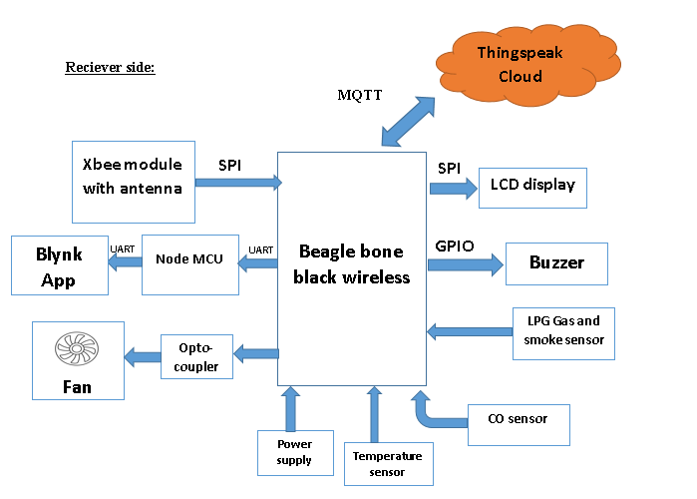
Project Description:
Our project is IoT based smart restaurant menu.
At the receiver side, we have added some safety measurements for kitchen staff.
We added various sensors such as smoke sensor , LPG gas sensor and temperature sensor to alert the kitchen staff about any leakage or temperature increase.

Slide 4
Use of Blynk App in our project
Once the sensors detect any smoke or LPG leakage, we have added a system which will send a notification as well as E-mail to the owner of restaurant and fire department.
For this purpose, we are using Blynk app which is directly connected to the Node MCU ESP8266 ,which is further connected to BBB-WI.
Once any leakage or smoke is detected by BBB, it will send a signal to Node MCU which is connected to Blynk app and therefore Blynk app in turn sends the notification to restaurant owner as well as fire department.

Slide 5
Why we used Node MCU ESP8266
For using Blynk app, we could not directly connect it to BBB-WI, because it is not compatible with Beaglebone Black board.
While using new project in Blynk app, we need to specify which board we are going to use and there is not any option for BBB-WI.
So, the only other way we had was to interface it through Node MCU.
As it has Wi-Fi connectivity and is compatible to use with Arduino IDE, so we used Node MCU ESP8266.

Slide 6
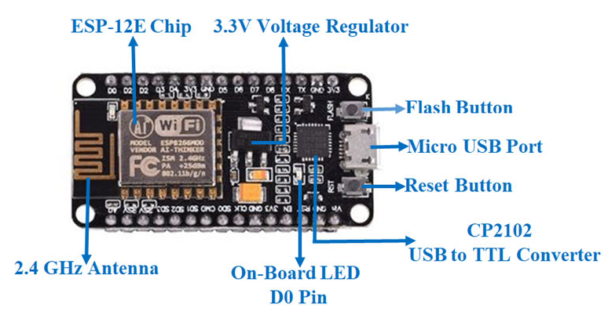
Node MCU 8266:
NodeMCU is an open-source Lua based firmware and development board specially targeted for IoT based Applications.
It includes firmware that runs on the ESP8266 Wi-Fi SoC from Espressif Systems, and hardware which is based on the ESP-12 module.
This microprocessor supports RTOS and operates at 80MHz to 160 MHz adjustable clock frequency.
NodeMCU has 128 KB RAM and 4MB of Flash memory to store data and programs. Its high processing power with in-built Wi-Fi / Bluetooth and Deep Sleep Operating features make it ideal for IoT projects.
NodeMCU can be powered using Micro USB jack and VIN pin (External Supply Pin). It supports UART, SPI, and I2C interface.

Slide 7
Specifications and features:
Microcontroller: Tensilica 32-bit RISC CPU Xtensa LX106
Operating Voltage: 3.3V
Input Voltage: 7-12V
Digital I/O Pins (DIO): 16
Analog Input Pins (ADC): 1
UARTs: 1
SPIs: 1
I2Cs: 1
Flash Memory: 4 MB
SRAM: 64 KB
Clock Speed: 80 MHz
USB-TTL based on CP2102 is included onboard, Enabling Plug n Play
PCB Antenna
Small Sized module to fit smartly inside your IoT projects

Slide 8
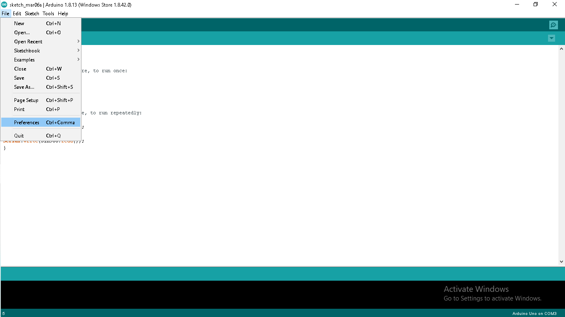
Setting Arduino IDE for Node MCU :Adding ESP8266 Board Manager on Arduino IDE
Open Arduino IDE
File > Preferences:

Slide 9
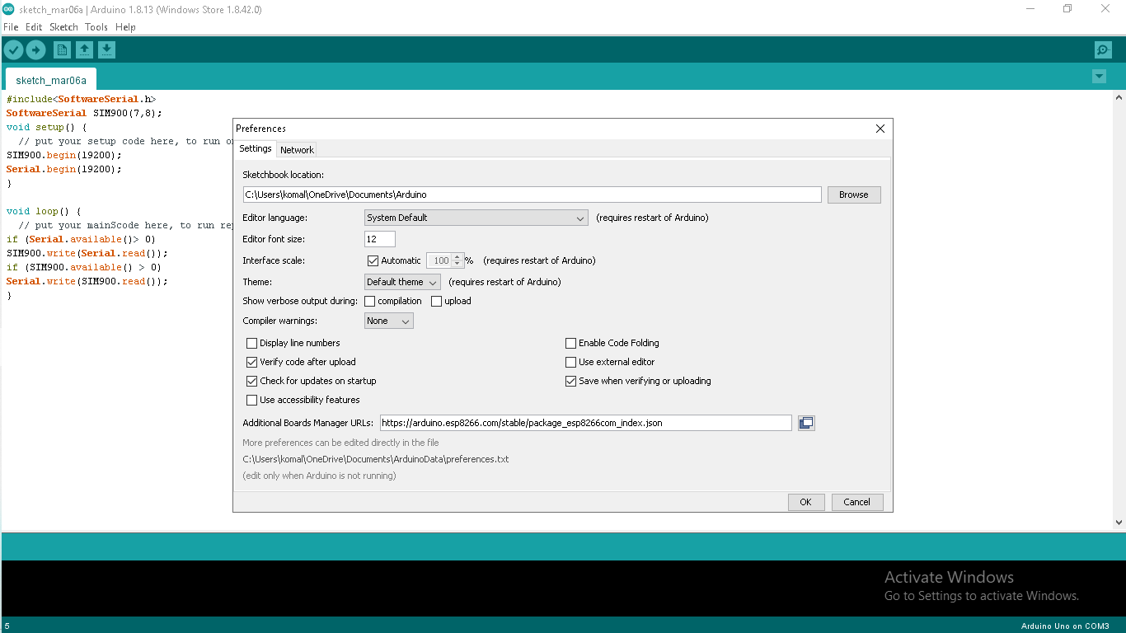
Adding ESP8266 Board Manager
In the “additional board Manager URLs” put the link of json file below
http://arduino.esp8266.com/stable/package_esp8266com_index.json

Slide 10
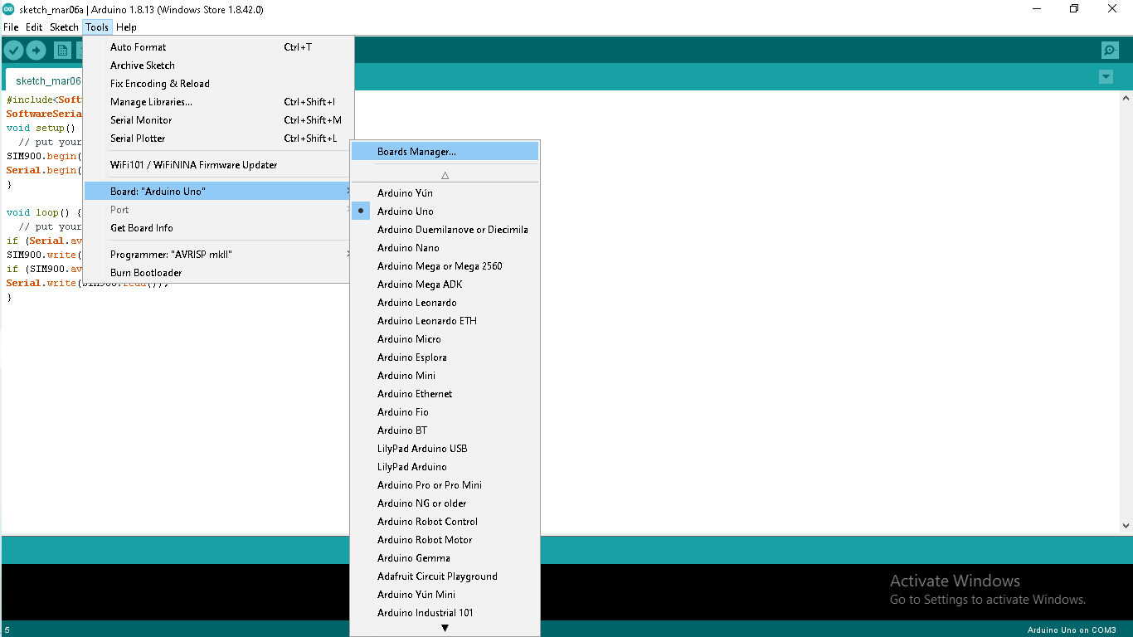
Selecting Board to install libraries
Open Board Manager :

Slide 11
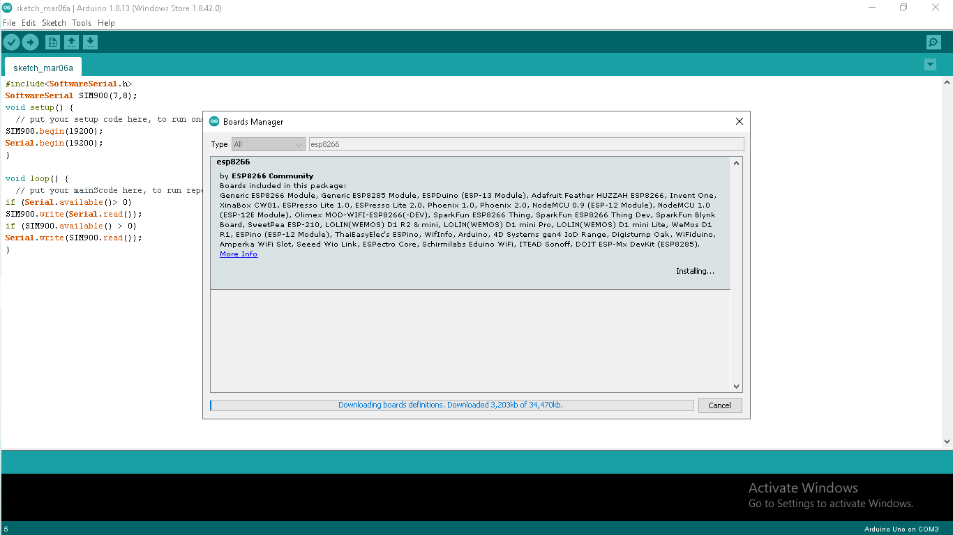
Install ESP8266 Board Package
Now, we need to search for esp8266 and install library as shown.

Slide 12
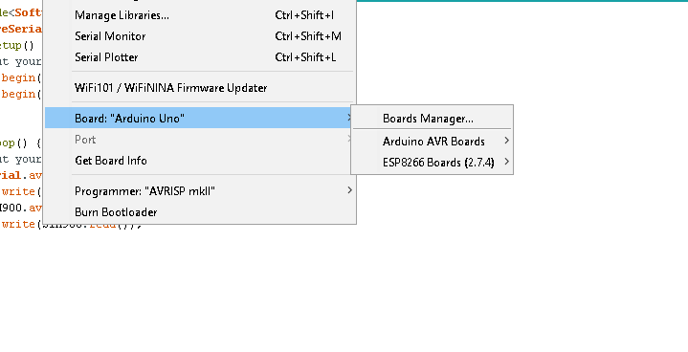
Installing libraries: ESP8266
After installing library, we can see that board ESP8266(2.7.4) have been added in the available boards.

Slide 13
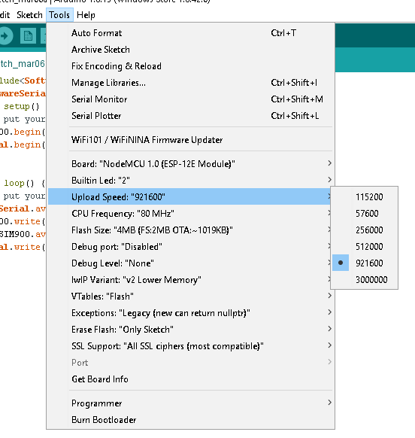
Changing uploading speed:
We need to change the upload speed to 92160,because otherwise it will take a lot of time to upload code to Node MCU.
There is no any other change needed to do, so we kept them intact.
After this board setup in IDE is completed.

Slide 14

Blynk Application
Blynk app for iOS and Android is the easiest way to build own mobile app that work with the hardware of our choice.
No iOS or Android coding is required for this purpose.
Blynk supports hardware platforms such as Arduino, Raspberry Pi, and similar microcontroller boards to build hardware for projects.

Slide 15
Blynk Application
Blynk was designed for the Internet of Things. It can control hardware remotely, it can display sensor data, it can store data, visualize it and do many other things.
There are three major components in the platform:
Blynk App - allows us to create amazing interfaces for projects using various widgets provided.
Blynk Server - responsible for all the communications between the smartphone and hardware. It’s open-source, could easily handle thousands of devices .
Blynk Libraries - for all the popular hardware platforms - enable communication with the server and process all the incoming and outgoing commands.

Slide 16
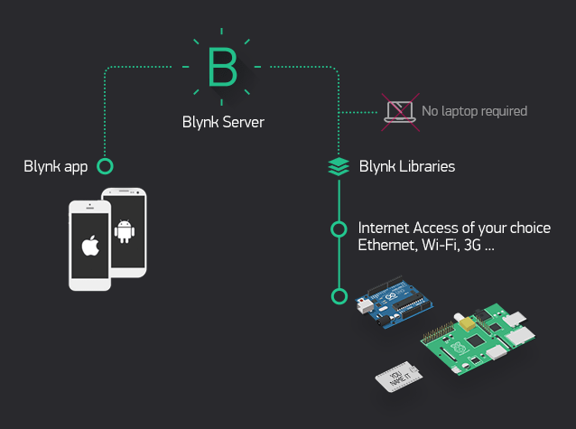
Working of Blynk app:

Slide 17
Features of Blynk app:
Similar API & UI for all supported hardware & devices
Connection to the cloud can be done using:
  Wi-Fi
  Bluetooth
  Ethernet
  USB (Serial)
  GSM
Set of easy-to-use Widgets
Direct pin manipulation with no code writing
Easy to integrate and add new functionality using virtual pins
Device-to-Device communication using Bridge Widget
Sending emails, tweets, push notifications, etc.

Slide 18
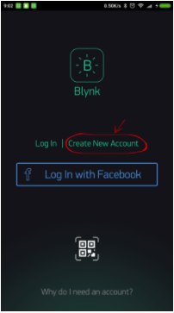
Getting started with Blynk app:
We can download this app through play store for android or App store for iPhone.
After this , we need to create a new account on Blynk App, for this we need an email account and password.
After creating new account, first step is to create a new project.

Slide 19
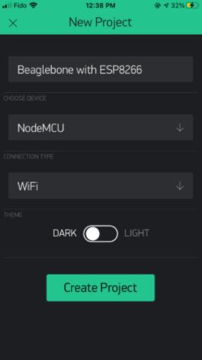
Creating a new project:
Click on new project and this screen will get opened.
After this, we need to give a project name.
We need to choose device from the drop down menu , as we selected Node MCU here.
After this , connection type need to be specified.
Here, I have chosen Wi-Fi connection.

Slide 20
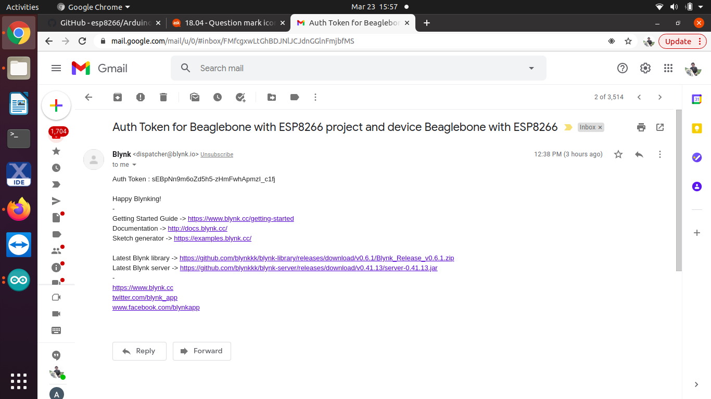
Auth Token
Once we click on create project, an authorization token is sent to our registered email address.
Auth Token is a unique identifier which is needed to connect hardware to your smartphone.
Every new project we create will have its own Auth Token.
We will get Auth Token automatically on email after project creation.

Slide 21
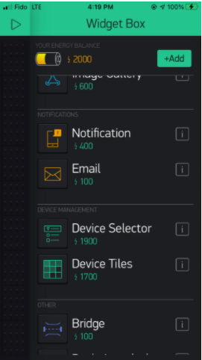
Adding widgets to project
We can add various widgets according to our project requirements; such as Button ,slider, timer, email alert etc.
Tap anywhere on the canvas to open the widget box. All the available widgets are located here.
In our project, I have added two notification widgets : Notification and email.

Slide 22
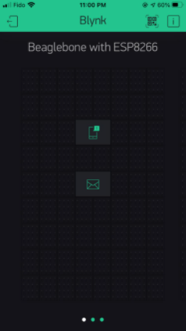
Final Interface
Final interface will look like this with two widgets added on it.
Widget Settings -
Each Widget has it’s own settings. Tap on the widget and small “I” button to get to them.
API function associated with that widget is also mentioned in content,
which I showed in next slide.

Slide 23
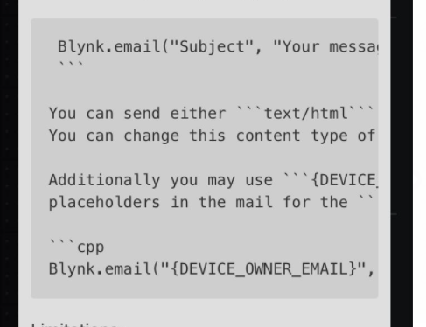
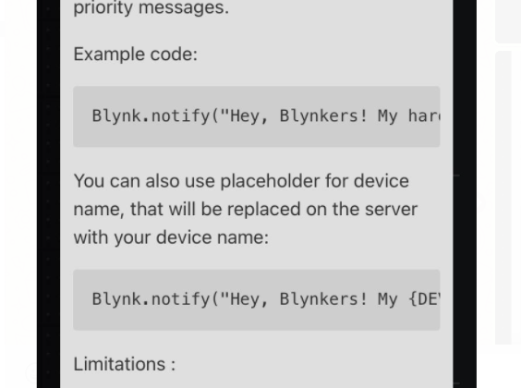
Widget information:
Email Widget
Notification Widget

Slide 24
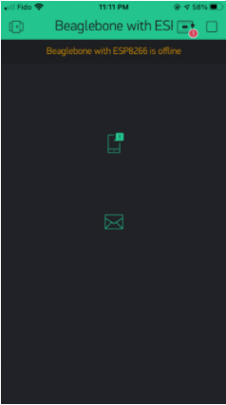
Run The Project
When we are done with the Settings - press the PLAY button.
This will switch from EDIT mode to PLAY mode where we can interact with the hardware.
While in PLAY mode, we won’t be able to drag or set up new widgets,
We have not connected any device to communicate , so it is showing device is offline.

Slide 25
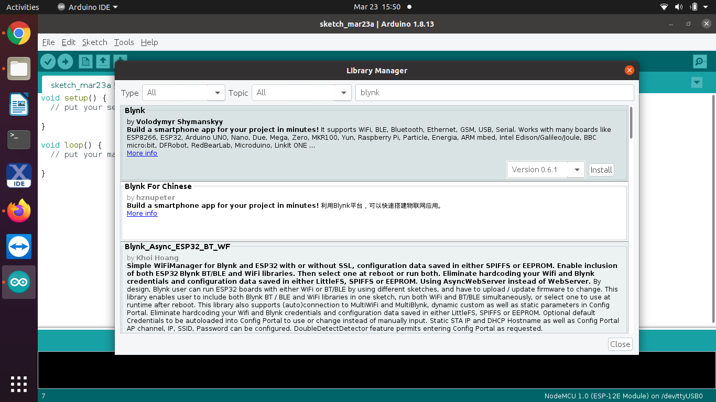
Connecting ESP8266 with PC
As we have done all the settings for Arduino in previous slides, next step is to download library for Blynk App from Library manager
We need to download library named Blynk and select its latest version to install.

Slide 26
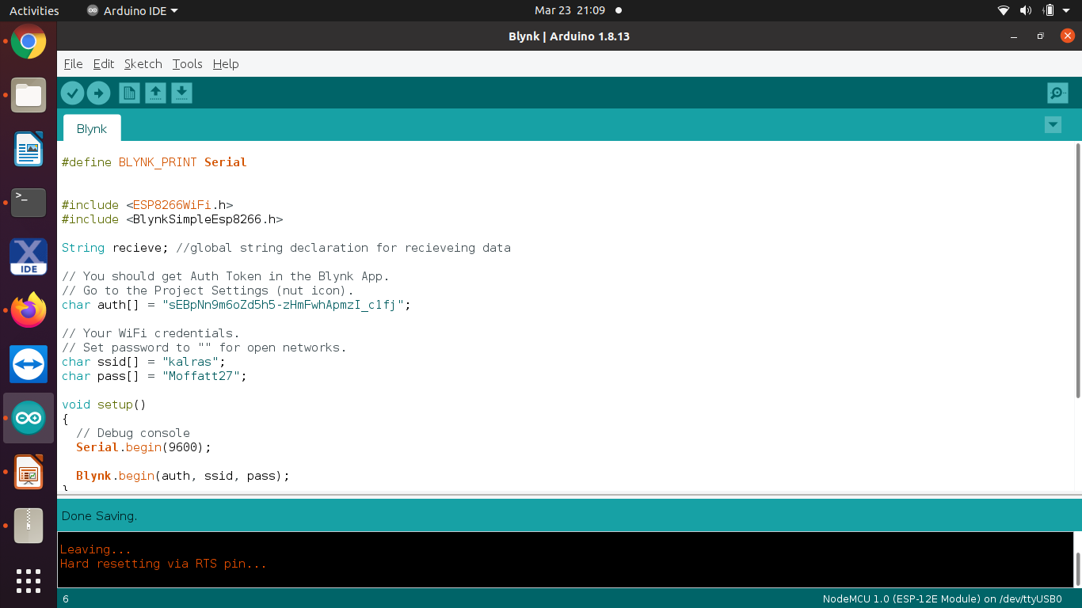
Importing example code from library
After installing library, we can open example code from this library.
Open File > Examples > Blynk > Blynk w-ifi >Blynk_wi-fi_standalone

Slide 27
Adding API functions:
After importing example code, we added two API functions according to our project requirements.
Blynk.notify()
  This function is associated with notification widget. We can print any string by passing it in its argument.
Blynk.email()
  Thisfunction is associated with email notification.
  We need to pass three arguments in this function: Email_id , Subject of email and Body of email.

Slide 28
Code explanation:
Header files used:
#define BLYNK_PRINT Serial
The compiler will replace any mention of BLYNK_PRINT with the Serial at compile time.
#include <ESP8266WiFi.h>
This library provides ESP8266 specific Wi-Fi routines that we are calling to connect to the network.
#include <BlynkSimpleEsp8266.h>
This library is associated with Blynk application

Slide 29
Code explanation:
We should get Auth Token in the Blynk App.
Go to the Project Settings (nut icon).
char auth[] = "sEBpNn9m6oZd5h5-zHmFwhApmzI_c1fj";
Set WiFi credentials.
Set password to "" for open networks.
char ssid[] = "kalras";
char pass[] = "Moffatt27";

Slide 30
Code explanation:
void setup()
The setup() function is called when a sketch starts. Use it to initialize variables, pin modes, start using libraries, etc. The setup() function will only run once, after each powerup or reset of the Arduino board.
Serial.begin(9600);
Sets the data rate in bits per second (baud) for serial data transmission
Blynk.begin(auth, ssid, pass);
This function needs 3 arguments and is responsible for initializing Blynk app
Blynk.run();
Blynk.run() is a main Blynk routine responsible for keeping connection alive, sending data, receiving data, etc.

Slide 31
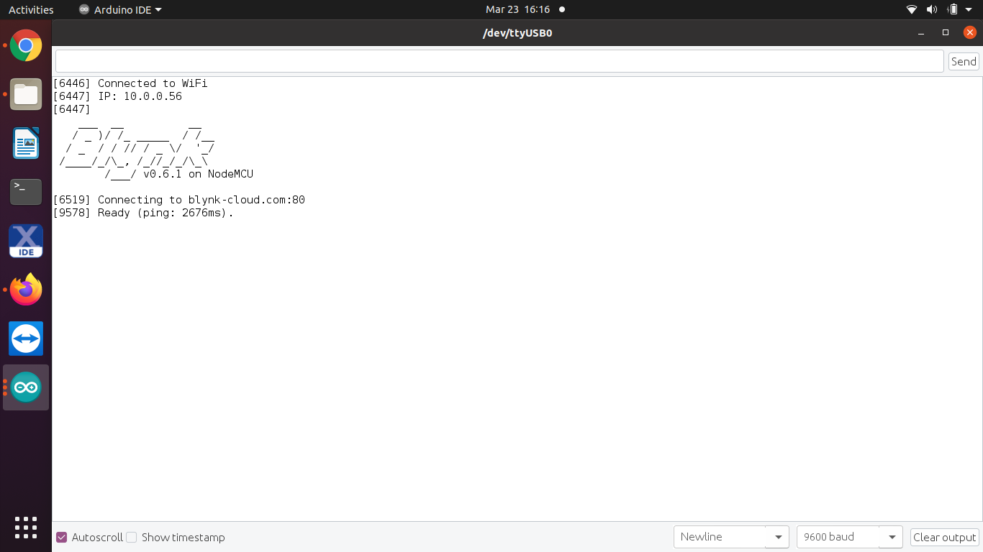
Code compilation:
After compiling and uploading code, we can see Blynk app logo on the serial monitor.
It is an indication that Blynk app is succesfully configured with ESP8266.

Slide 32
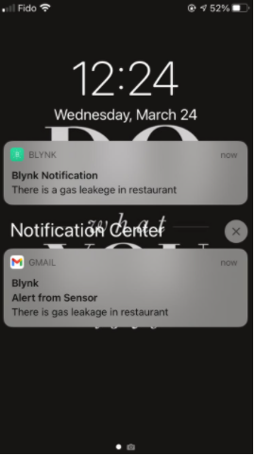
Output on Blynk Application:
After uploading code on Arduino side and also entering into play mode of Blynk App, we can see following output notification on Blynk App
An email is also visible on the output side, which is sent to the same email address provided.

Slide 33
References:
Downloading libraries:
https://github.com/esp8266/Arduino
Set up Arduino IDE for Node MCU 8266
https://www.instructables.com/Steps-to-Setup-Arduino-IDE-for-NODEMCU-ESP8266-WiF/
Arduino coding formats:
https://www.arduino.cc/reference/en/language/structure/further-syntax/define/
Setting Arduino IDE with Node MCU
https://www.instructables.com/Steps-to-Setup-Arduino-IDE-for-NODEMCU-ESP8266-WiF/
Blynk App setup
https://docs.blynk.cc/

Slide 34
References:
Specifications of Node MCU
https://components101.com/development-boards/nodemcu-esp8266-pinout-features-and-datasheet
Interfacing Blynk app with ESP8266
https://www.geekstips.com/esp8266-email-and-push-notifications-iot-blynk/

